Slide 1
Attention Mechanism

Slide 2
Outline
Limitations of Encoder-Decoder
Similarity Score
Attention Mechanism

Slide 3
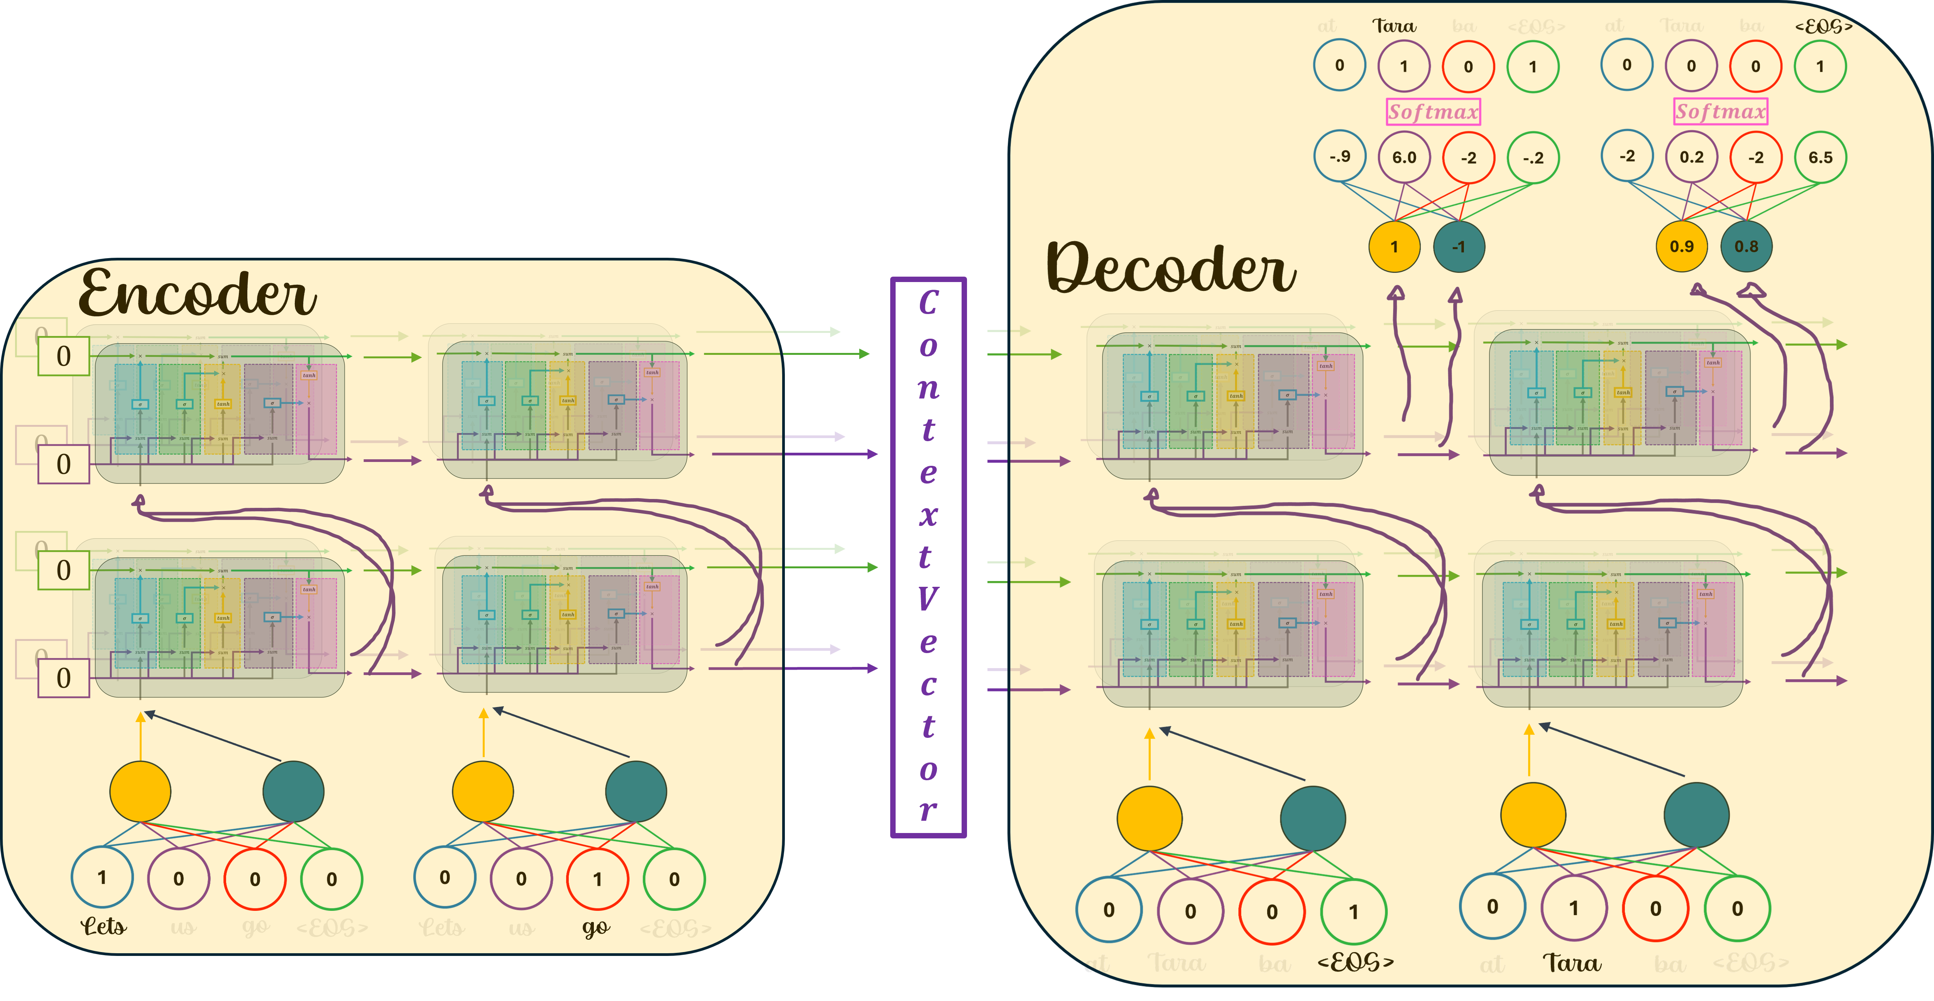
The problem in a basic Encoder-Decoder is it compresses the entire input sentence into a single context vector

Slide 4
This is fine for short phrases like “How are you?”

Slide 5
But if we had a bigger input vocabulary with 1000’s words, then we could input longer and more complicated sentences

Slide 6
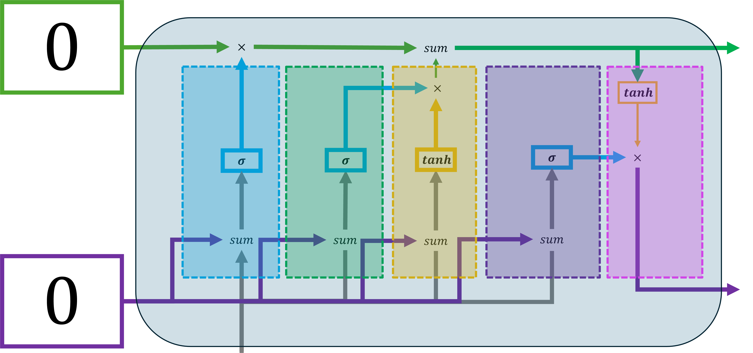
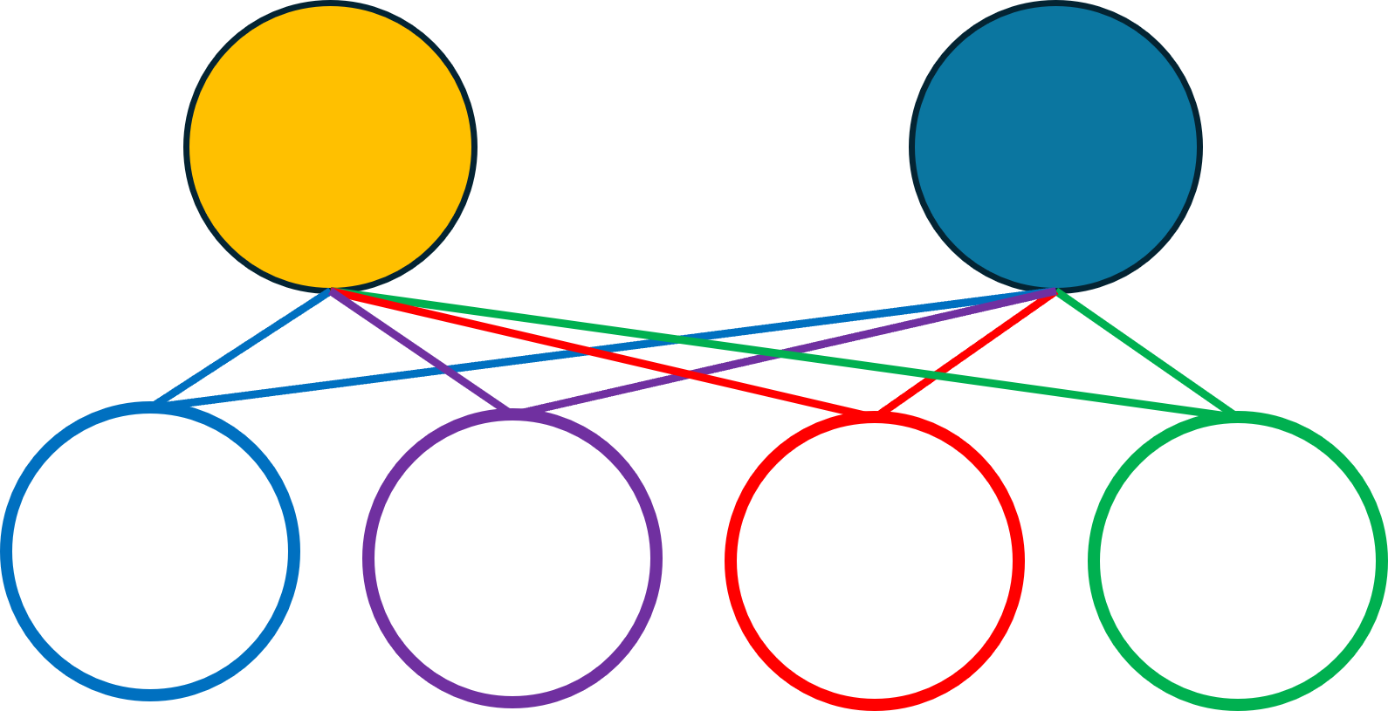
Encoder
Time

Slide 7
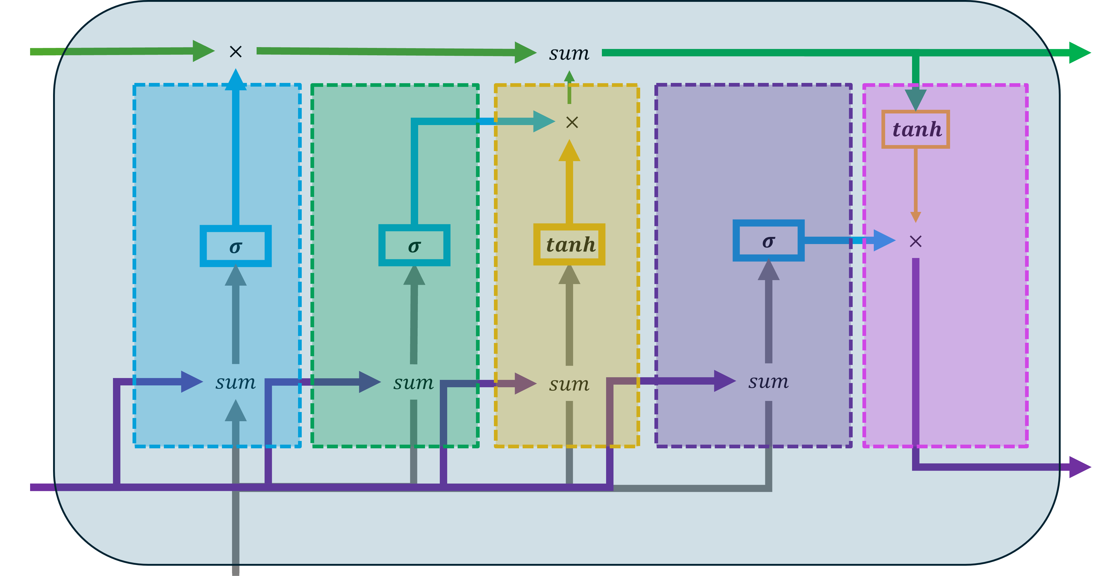
Encoder
Time
heals

Slide 8
Encoder
Time
heals
all

Slide 9
Encoder
Time
heals
all
old

Slide 10
Even with LSTMs, words that are in the beginning can be forgotten
Encoder
Time
heals
all
old
wounds

Slide 11
In this case, if we forget the first word “Time”, the sentence will have a very different meaning.
Encoder
Time
heals
all
old
wounds

Slide 12
Even with separate paths for long term term and short term memories, both paths have to carry a lot of information.
Encoder
Time
heals
all
old
wounds

Slide 13
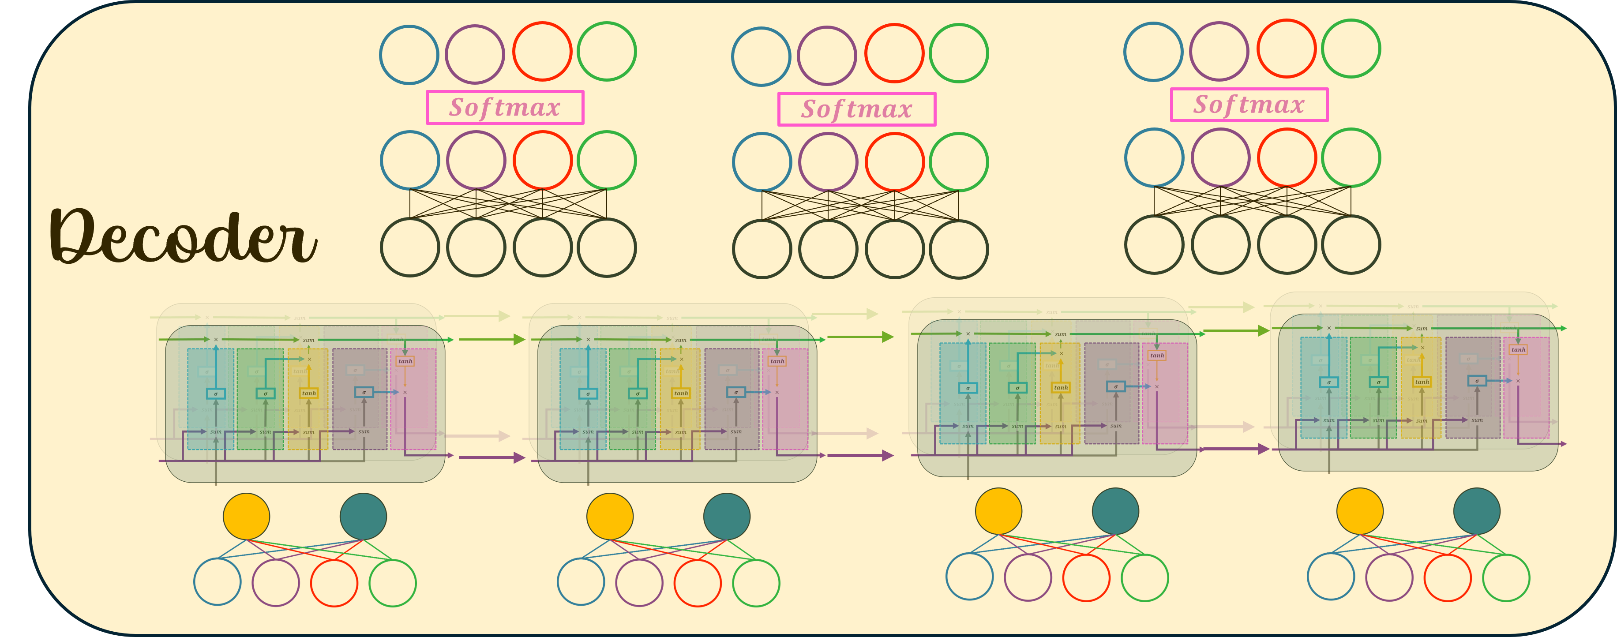
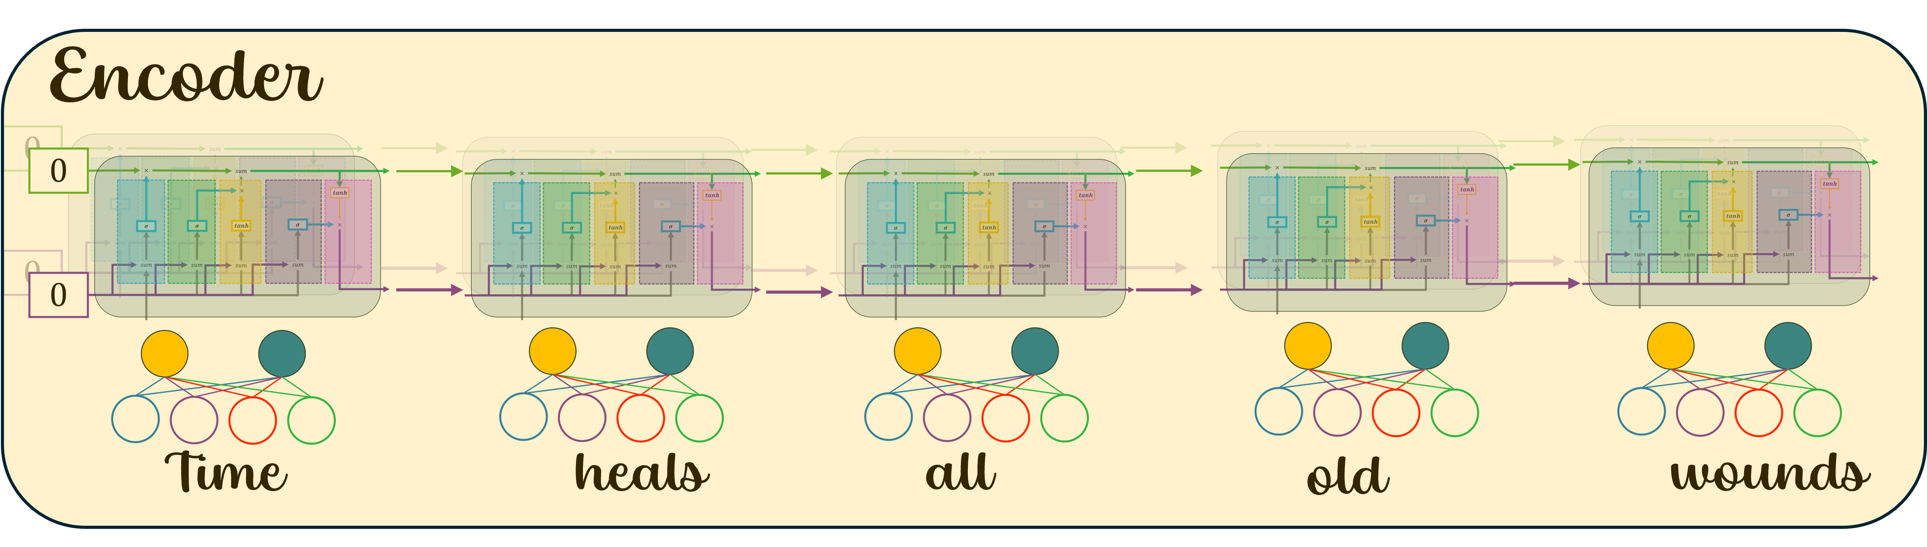
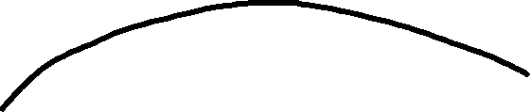


The idea of Attention is to add a path for all inputs to the Decoder so that each step of the Decoder can directly access input values

Slide 14
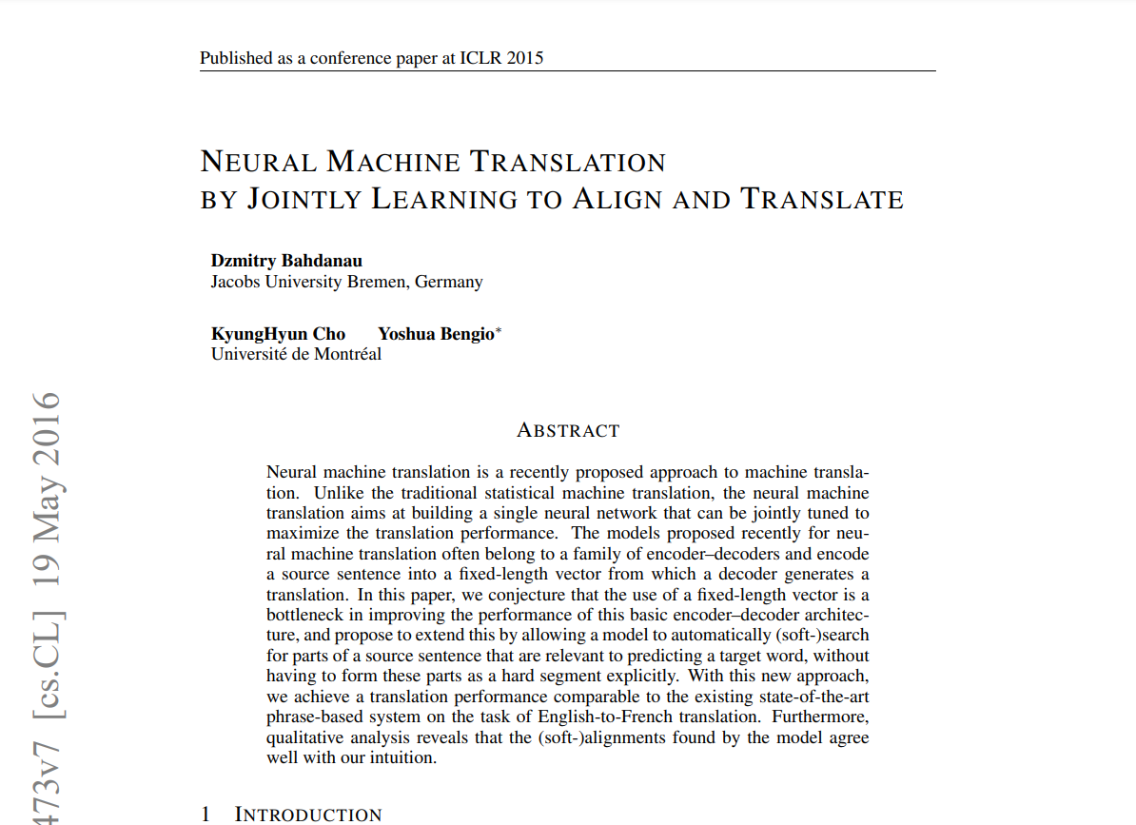
Original Attention Mechanism Paper
Bahdanau et.al introduced soft attention allowing the model to dynamically focus on relevant parts of the input sequence when generating each word in the output.

Slide 15
Original Attention Mechanism Paper
This overcame limitations of encoding entire input sequences into a fixed-size vector as done in earlier encoder-decoder models.
https://arxiv.org/pdf/1409.0473

Slide 16
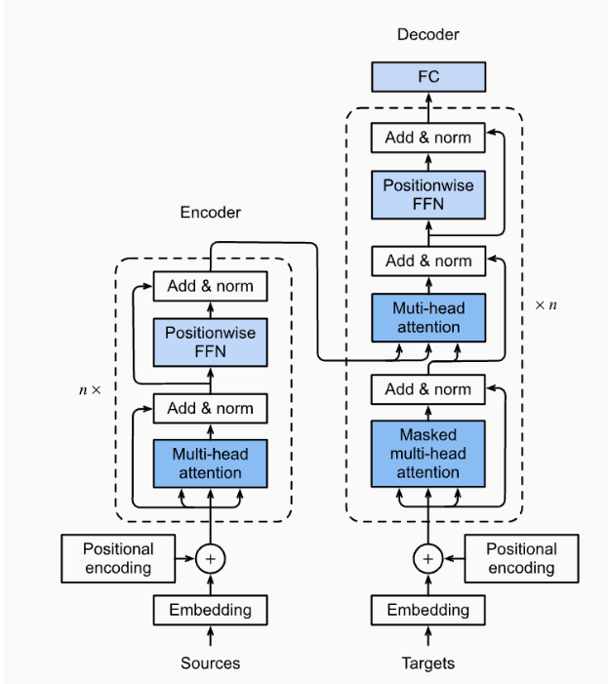
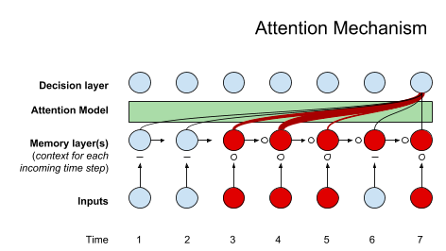
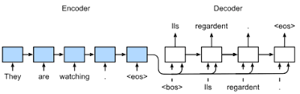
Seq2Seq
Attention
Transformers
The Attention mechanism is a step towards understanding Transformers, which forms the basis of Large Language Models like OpenAI’s GPT models.

Slide 17
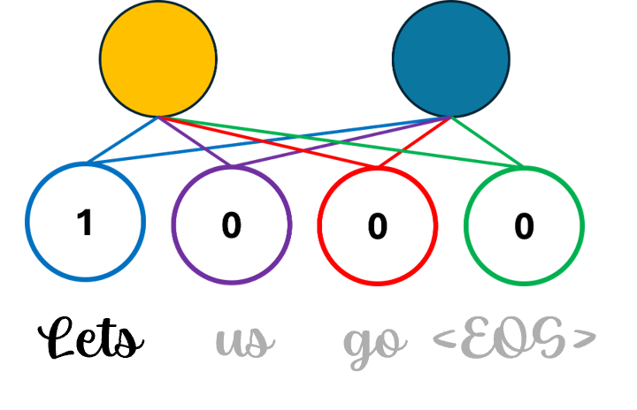
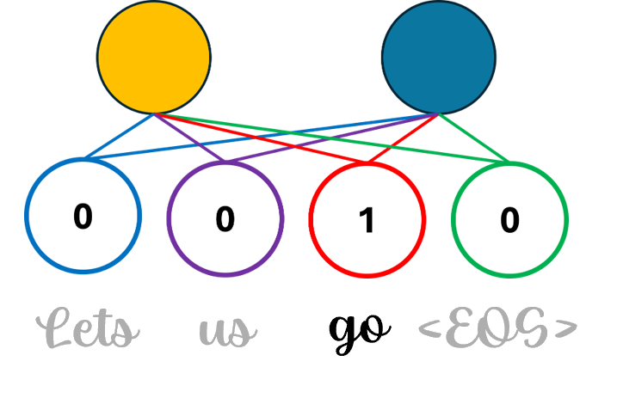
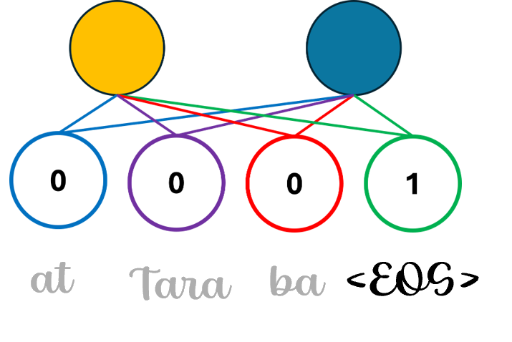
Encoder

Slide 18
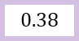
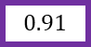
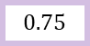
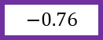
$$0.75$$
$$−0.76$$
$$0.91$$
Encoder
$$0.38$$

Slide 19
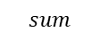


$$sum$$
$$×$$
$$×$$
$$0.75$$
$$−0.76$$
$$0.91$$
Encoder
$$0.38$$

Slide 20
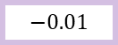
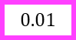
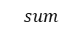
$$sum$$
$$sum$$
$$×$$
$$×$$
$$×$$
$$0.75$$
$$×$$
$$−0.76$$
$$−0.01$$
$$0.91$$
Encoder
$$0.01$$
$$0.38$$

Slide 21
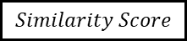
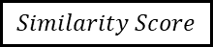
$$Similarity Score$$
$$Similarity Score$$
$$sum$$
$$sum$$
$$×$$
$$×$$
$$×$$
$$0.75$$
$$×$$
$$−0.76$$
$$−0.01$$
$$0.91$$
Encoder
$$0.01$$
$$0.38$$

Slide 22
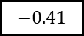
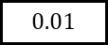
$$−0.41$$
$$0.01$$
$$sum$$
$$sum$$
$$×$$
$$×$$
$$×$$
$$0.75$$
$$×$$
$$−0.76$$
$$−0.01$$
$$0.91$$
Encoder
$$0.01$$
$$0.38$$

Slide 23
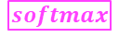
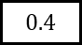
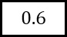
$$0.4$$
$$0.6$$
$$softmax$$
$$−0.41$$
$$0.01$$
$$sum$$
$$sum$$
$$×$$
$$×$$
$$×$$
$$0.75$$
$$×$$
$$−0.76$$
$$−0.01$$
$$0.91$$
Encoder
$$0.01$$
$$0.38$$

Slide 24

$$×$$
$$×$$
$$0.4$$
$$0.6$$
$$softmax$$
$$−0.41$$
$$0.01$$
$$sum$$
$$sum$$
$$×$$
$$×$$
$$×$$
$$0.75$$
$$×$$
$$−0.76$$
$$−0.01$$
$$0.91$$
Encoder
$$0.01$$
$$0.38$$

Slide 25

$$×$$
$$×$$
$$×$$
$$×$$
$$0.4$$
$$0.6$$
$$softmax$$
$$−0.41$$
$$0.01$$
$$sum$$
$$sum$$
$$×$$
$$×$$
$$×$$
$$0.75$$
$$×$$
$$−0.76$$
$$−0.01$$
$$0.91$$
Encoder
$$0.01$$
$$0.38$$

Slide 26
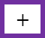

$$×$$
$$+$$
$$×$$
$$+$$
$$×$$
$$×$$
$$0.4$$
$$0.6$$
$$softmax$$
$$−0.41$$
$$0.01$$
$$sum$$
$$sum$$
$$×$$
$$×$$
$$×$$
$$0.75$$
$$×$$
$$−0.76$$
$$−0.01$$
$$0.91$$
Encoder
$$0.01$$
$$0.38$$

Slide 27
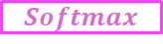
$$×$$
$$+$$
at
Tara
ba
<EOS>
$$×$$
$$+$$
$$×$$
$$×$$
$$Softmax$$
$$0.4$$
$$0.6$$
$$softmax$$
$$−0.41$$
$$0.01$$
$$sum$$
$$sum$$
$$×$$
$$×$$
$$×$$
$$0.75$$
$$×$$
$$−0.76$$
$$−0.01$$
$$0.91$$
Encoder
$$0.01$$
$$0.38$$

Slide 28
$$×$$
$$+$$
at
Tara
ba
<EOS>
$$×$$
$$+$$
$$×$$
$$×$$
$$Softmax$$
$$0.4$$
$$0.6$$
$$softmax$$
$$−0.41$$
$$0.01$$
-0.3
0.3
$$sum$$
$$sum$$
$$×$$
$$×$$
$$×$$
$$0.75$$
$$×$$
$$−0.76$$
$$−0.01$$
$$0.91$$
Encoder
$$0.01$$
$$0.38$$

Slide 29
$$×$$
$$+$$
at
Tara
ba
<EOS>
$$×$$
$$+$$
$$×$$
$$×$$
$$Softmax$$
$$0.4$$
$$0.6$$
$$softmax$$
$$−0.41$$
$$0.01$$
-0.3
0.3
0.9
0.4
$$sum$$
$$sum$$
$$×$$
$$×$$
$$×$$
$$0.75$$
$$×$$
$$−0.76$$
$$−0.01$$
$$0.91$$
Encoder
$$0.01$$
$$0.38$$

Slide 30
$$×$$
$$+$$
at
Tara
ba
<EOS>
$$×$$
$$+$$
0
1
0
0
$$×$$
$$×$$
$$Softmax$$
-0.7
4.7
-2
-2
$$0.4$$
$$0.6$$
$$softmax$$
$$−0.41$$
$$0.01$$
-0.3
0.3
0.9
0.4
$$sum$$
$$sum$$
$$×$$
$$×$$
$$×$$
$$0.75$$
$$×$$
$$−0.76$$
$$−0.01$$
$$0.91$$
Encoder
$$0.01$$
$$0.38$$

Slide 31
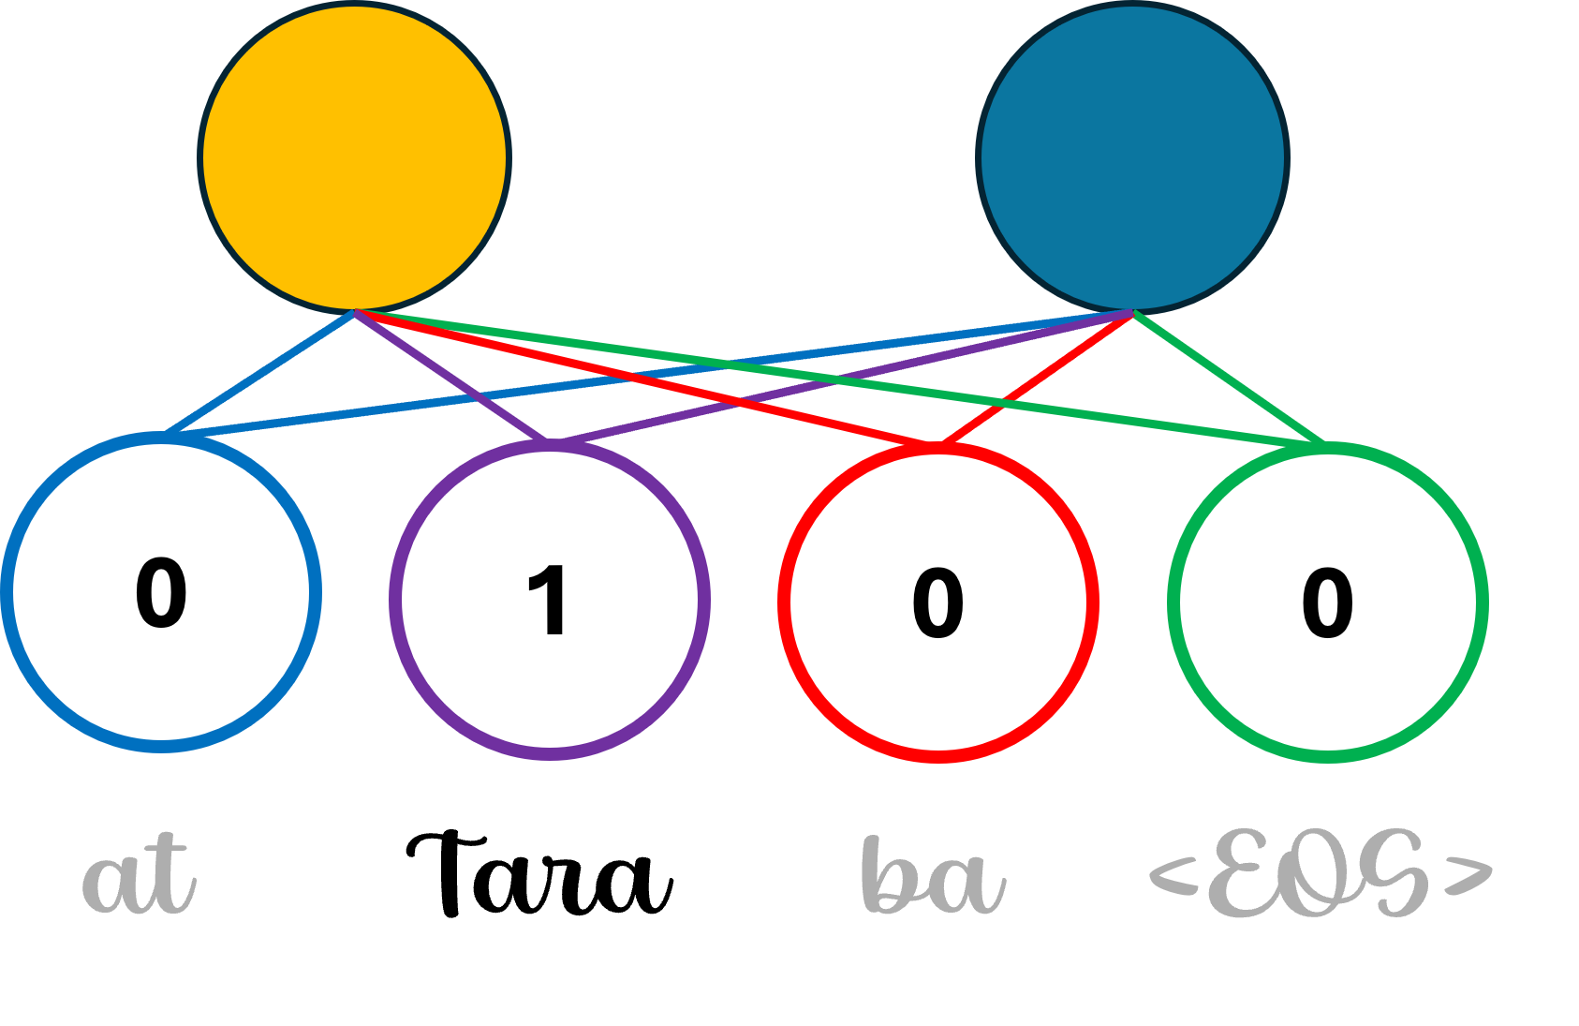
$$×$$
$$+$$
at
Tara
ba
<EOS>
$$×$$
$$+$$
0
1
0
0
$$×$$
$$×$$
$$Softmax$$
-0.7
4.7
-2
-2
$$0.4$$
$$0.6$$
$$softmax$$
$$−0.41$$
$$0.01$$
-0.3
0.3
0.9
0.4
$$sum$$
$$sum$$
$$×$$
$$×$$
$$×$$
$$0.75$$
$$×$$
$$−0.76$$
$$−0.01$$
$$0.91$$
Encoder
$$0.01$$
$$0.38$$

Slide 32
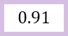
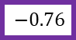
$$×$$
$$+$$
at
Tara
ba
<EOS>
$$×$$
$$+$$
$$×$$
$$×$$
$$Softmax$$
$$softmax$$
$$sum$$
$$sum$$
$$×$$
$$×$$
$$×$$
$$0.75$$
$$×$$
$$−0.76$$
$$−0.01$$
$$−0.76$$
Encoder
$$0.01$$
$$0.91$$

Slide 33
$$×$$
$$+$$
at
Tara
ba
<EOS>
$$×$$
$$+$$
$$×$$
$$×$$
$$Softmax$$
0.78
0.22
$$softmax$$
1.26
-0.01
$$sum$$
$$sum$$
$$×$$
$$×$$
$$×$$
$$0.75$$
$$×$$
$$−0.76$$
$$−0.01$$
$$−0.76$$
Encoder
$$0.01$$
$$0.91$$

Slide 34
$$×$$
$$+$$
at
Tara
ba
<EOS>
$$×$$
$$+$$
0
0
0
1
$$×$$
$$×$$
$$Softmax$$
-0.5
1.4
-2
7.4
0.78
0.22
$$softmax$$
1.26
-0.01
-0.6
0.6
-0.76
0.91
$$sum$$
$$sum$$
$$×$$
$$×$$
$$×$$
$$0.75$$
$$×$$
$$−0.76$$
$$−0.01$$
$$−0.76$$
Encoder
$$0.01$$
$$0.91$$

Slide 35
$$×$$
$$+$$
at
Tara
ba
<EOS>
$$×$$
$$+$$
0
0
0
1
$$×$$
$$×$$
$$Softmax$$
-0.5
1.4
-2
7.4
0.78
0.22
$$softmax$$
1.26
-0.01
-0.6
0.6
-0.76
0.91
$$sum$$
$$sum$$
$$×$$
$$×$$
$$×$$
$$0.75$$
$$×$$
$$−0.76$$
$$−0.01$$
$$−0.76$$
Encoder
$$0.01$$
$$0.91$$
Decoder

Slide 36
References
https://arxiv.org/pdf/1409.0473
https://lena-voita.github.io/nlp_course/seq2seq_and_attention.html

